Slide 1

Induction Manual for New Joiners
AI and Data
August 2021

Slide 2
4
Deloitte Overview
Deloitte Services
Consulting Services
AI & Data
Analytics Capability
A&C Sectoral Offerings
A&C User Onboarding
Mandatory Learning Tracker
Industry Learnings
Tom Riddick
Position: Creative Director Experience: 10 years
Agenda
Tom Riddick
Position: Creative Director Experience: 10 years
www.corporateproposal.com

Slide 3
Key Capabilities
Our Consulting Practice
Deloitte Consulting
STRATEGY, ANALYTICS AND M&A
DIGITAL CUSTOMER & MARKETING STRATEGY
CORE BUSINESS OPERATIONS
HUMAN CAPITAL
ENTERPRISE TECHNOLOGY & PERFORMANCE
Strategy & Business Design
Customer Strategy & Applied Design
Operations Transformation
HR Transformation
Technology Strategy & Transformation
AI & Data
Advertising, Marketing & Commerce
Cloud Engineering
Organization Transformation
SAP
Mergers & Acquisitions
Digital Customer
Workforce Transformation
Oracle
Emerging ERP Solutions
Finance & Performance
Supply Chain & Network Operations

Slide 4
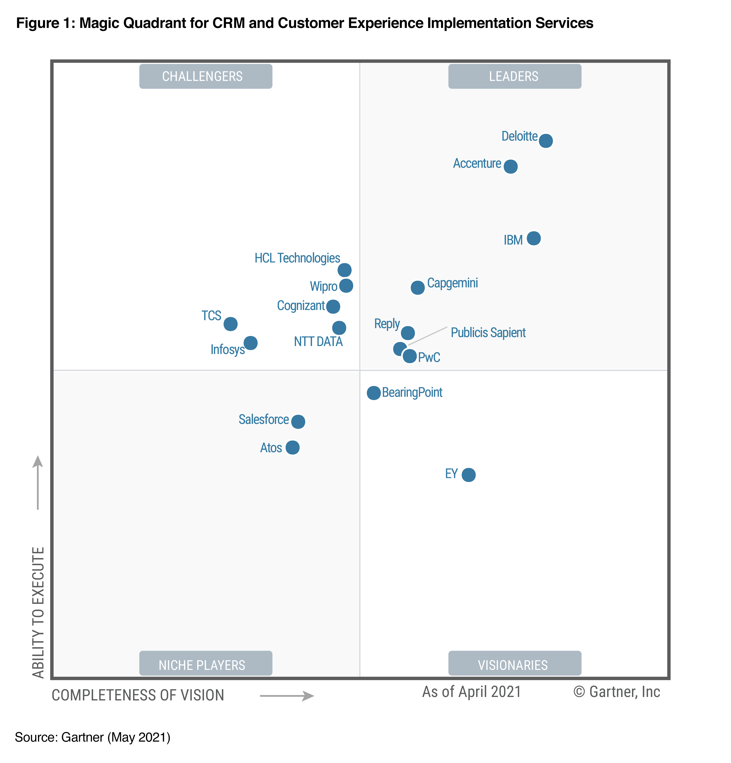
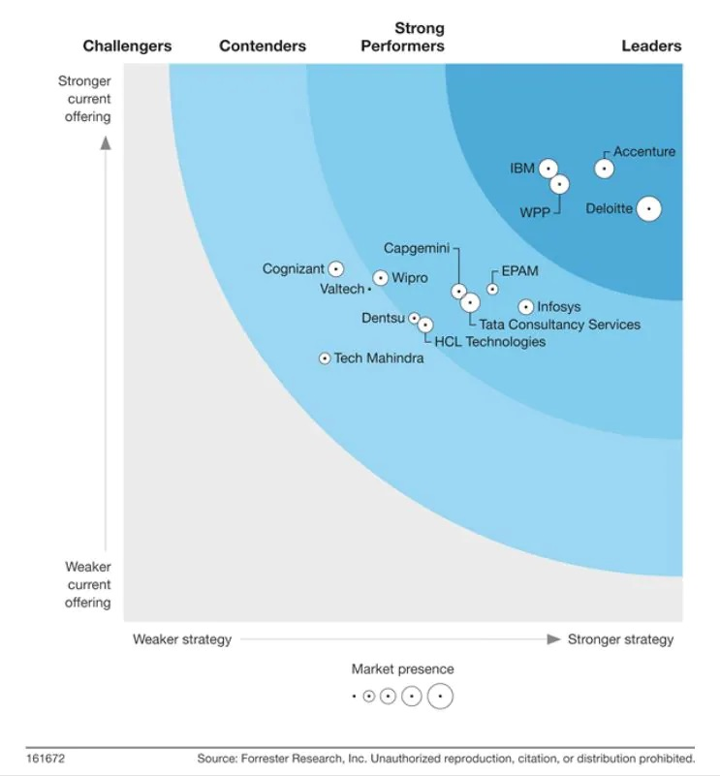

Deloitte is the #1 Consulting Service Provider in the World
Deloitte is consistently recognized as a global leader in Business Transformation, Data Analytics and HR Technology Advisory Services by ALM Intelligence- Kennedy, Forrester and Gartner
Gartner
Forrester
Deloitte named the undisputed worldwide leader in Analytics and Implementation Services
- Gartner 2021
Deloitte is positioned in the leaders quadrant
and rated #1 for market presence. Also, clients appreciated Data services provided by Deloitte
Awards and Recognitions
Deloitte ranked as “Undisputed Leader” for Data and Analytics Services in Gartner’s Magic Quadrant 2019
Deloitte named as “Undisputed Leader” for Robotic Process Automation Services in Forrester’s Q4 Wave 2019
Deloitte named “Worldwide Leader” for Artificial Intelligence Services 2019 by IDC
Deloitte named as “Global Leader” in Enterprise Insights Services Wave 2018 by Forrester
Deloitte named “worldwide leader” in Business Analytics Consulting and Systems Integration Services 2018 by IDC
Deloitte named “worldwide visionary” in Application Testing Services Worldwide Magic Quadrant 2017 by Gartner

Slide 5
Local presence
Deloitte India is one of the leading professional services firms, with a rich heritage of serving the best-in-class clients in India.
India clientele (November 2019 BT500*)
New Delhi
Serves
Serves
Ahmedabad
Jamshedpur
Consumer and Industrial Products
79
108
Vadodara
of
Energy & Resources
of
Kolkata
12000+
130
173
Mumbai
Hyderabad
companies
companies
Pune
Professionals
spread across
4
4
Goa
Serves
Serves
Bengaluru
61
26
Chennai
Financial Services
of
Life Sciences & Healthcare
of
Kochi
Coimbatore
95
43
companies
companies
Services in India
Assurance
Tax
Financial Advisory
Risk Advisory
Consulting
12
4
4
Serves
Serves
40
5
Tech, media & Telecom
of
Public Sector
of
cities
50
7
companies
companies
*BT500 - Business Today publication about India’s top 500 performing companies

Slide 6


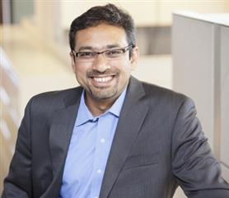




Deloitte India - Consulting Services
Core Business Operations
Digital Customer & Marketing
Enterprise Technology & Performance
Human Capital
Strategy, Analytics & M&A
Special Projects
Operations Transformation
Customer & Applied Design
Technology Strategy & Transformation
HR Transformation
Strategy & Business Design
SAP
Cloud Engineering
Advertising, Marketing & Commerce
Organization Transformation
AI & Data
Oracle & Emerging ERP
Digital Customer
Finance & Performance
Workforce Transformation
Merger & Acquisition
Supply Chain & Network Operations
Service Area Leader: Rajeev Singh
Service Area Leader: Ajit Kumar
Service Area Leader: Nitin Kini
Service Area Leader: Gaurav Lahiri
Service Area Leader: Viral Thakker
Service Area Leader: Gaurav Gupta

Slide 7



Leaders of Strategy, Analytics and M&A (SA&MA)Area
Strategy, Analytics and M&A (SA&MA)
Strategy & Business Design
AI & Data
Mergers & Acquisitions (M&A)
Service Lines
Service Line Leader:
S Anjani Kumar
Service Line Leader:
Saurabh Kumar
Service Line Leader:
Sumeet Salwan

Slide 8
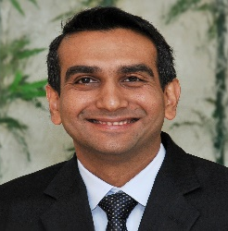


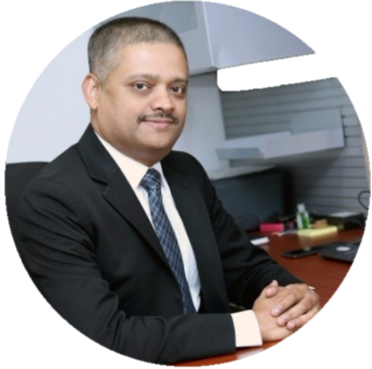

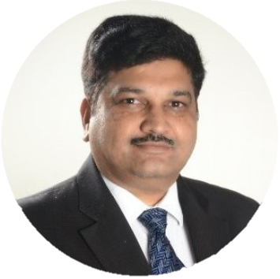
Partners
Leaders of Strategy, Analytics and M&A (SA&MA)Area
Executive Directors
Prashanth
Kaddi
Ankit Saran
Vijay
Gopalakrishnan
Monojit
Mazumdar
Nitin
Agrawal
Saurabh
Kumar
Vivek
Shrivastava
Directors
Jaidev Dutta
Hrishikesh Bhope
Srinivas Prasad G Batny
Data Visualization
Deliver Information
Data Science
RPA
Anjan Banikya
Abhishek Kala
Narayanan Raman
Sudharma Garge
Latesh Joshi
Aditya Khaitan
Nawneet Kishore
Srinivas Prasad Batny
Suman Banerjee
Varun Rastogi
Vishesh Tewari
Raghu A
Soumya Hansa
Sudarshan Cheripall

Slide 9
AI & Data

Slide 10




















































We have a strong BI, Big Data, Analytics and R&IA capability backed by strong credentials
Data Science
Delivery Information
Data Visualization
Robotics & Intelligent Automation (R&AI)
Artificial Intelligence
Machine Learning
Statistical Forecasting
Predictive modeling
Analytics CoE
Data Integration
Real time Data Ingestion
Data modeling & Architecture
Big Data strategy & migration
Integration & COE Setup
Enterprise Data Warehousing
Data Quality Management
Data Governance & Security
KPI Framework
Automated Dashboards/Reports
Storyboarding/ Information Layering
Role based CXO dashboards
Alerts and notifications
R&AI advisory & strategy development
R&AI implementation
R&AI Managed Services
COE development
Vendor selection
Our Team
440+
70+
120+
40+
Data Engineer
Data Scientist
Visualization Experts
RPA Experts
Select Clients
Venador Independent
Our Consultants are multi skilled with one technology as primary across the breadth of BI and Analytics architecture

Slide 11




















Our key BI dashboard and reporting offerings
Challenges
Large time and effort
Delayed strategy
Limited market
Conflicting
Multiple data sources
Resource intensive,
required for diagnosing
alignment due to
intelligence to drive
numbers/details in
leading to analysis
leading to high
inaccessible
relevant
the root cause
info
relevant insights
multiple reports
paralysis
reporting TAT
at
right
time
KPI Framework and
Storyboarding
KPI framework / information layering
Simplified root cause analysis with drill down capability
Role based executive CXO dashboards
Near real time data with alerts / notifications
Automated data workflow, scheduling
Full rating engine and analysis
Visualization Framework
Manage Data
Storyboarding
Build Dashboards
& Reports
Continuous Monitoring
Databases Data mart Data lake Data massaging ETL |  | KPI framework Information layering Storyboarding Descriptive, diagnostic, predictive analytics |  | Report development Charts customization Report deployment and sharing
Viewer specific frameworks for strategic, tactical and
operational level viewers
Automated MIS reports
Alerts and notifications
Present Statistical Analytics models through building
dashboards
Enablement of quick, data driven decisions
Executive Information Office
Setting up of Analytics center of excellence and its target
operating model
Effective decision support framework
Comparator benchmarking insights
Deep dive analysis for specific areas/ objectives
KPI library Strategic/ tactical/ operational KPIs

Slide 12
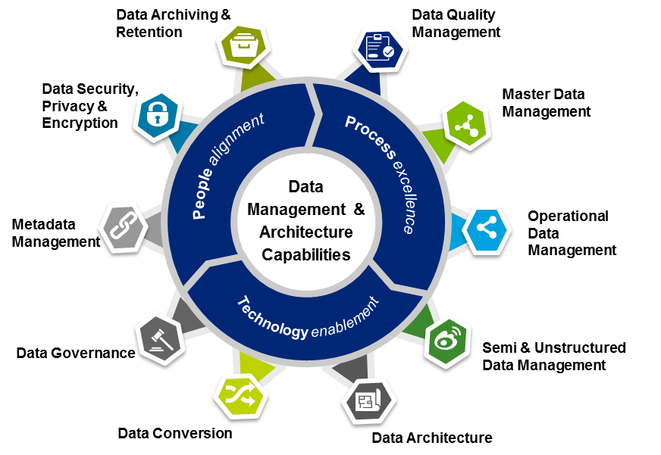
Deloitte’s basket of offerings across Enterprise Data and Architecture
Offerings
Capabilities
Industry Information Models
Data Management for Master Data, Operational Data, Semi and Unstructured Data
Advance Data Management
Data Quality
Data Governance
Data Security for Advanced Analytics
Managed Data Services and Solutions

Slide 13






Deloitte’s key advanced analytics offerings
Given the pace at which technology is changing, we’ve created a comprehensive and robust analytics ecosystem for insight-driven decision making across key business functions
Customer
Analytics
Marketing
Analytics
Digital
Analytics
Sales
Analytics
Operations Analytics
HR & Finance
Analytics
Understand
Customer Needs
Increase
Demand
Enrich Online
engagement
Create
High performance
sales-force
Optimize
Supply Chain
Enhancing HR &
Finance efficiency
One view of the customer
Customer Segmentation
Customer life time value
Quality of Acquisition
Customer life management models (Cross sell & Up-sell)
Churn Prediction
Loyalty analytics
Next best action
Marketing Mix Modeling
Marketing Spend Optimization
What-if analysis
Price sensitivity analysis and Optimization
Reach & Frequency Analysis
Trade & Consumer Promotion ROI analysis
Affinity analysis
Social media analytics
Search Analytics
User Interface Experience Development
Sentiment Analysis
Precision marketing
Journey Modeling
Sales force effectiveness
Field Target Setting
Incentive management
Territory management
Comprehensive sales dashboard
Inventory Planning and Management
Sales and Demand Forecasting
Order Fulfillment and scheduling
Network Optimization
Route-to market
Sourcing Strategy
Proactive Sensing
Talent and workforce analytics
Attrition prediction
Manpower planning and scheduling
Finance and Performance Analytics
Digital Finance workforce
Revenue Forecasting
ML OPS

Slide 14

Welcome to Deloitte

Slide 15
AI & Data Learning Tracker

Slide 16
Training Calendar (New Joiners) – Links to courses
Activity | Week Starting
Induction Session – AI & Data | Aug’21 Week 1
Module 1 | Aug’21 (Week 1 to Week 2)
Knowledge Repository | You will be added automatically
Presentation - Basics | Presentation Basics
Presentation - Advanced | Trainer led
Excel | Excel
Module 2 | Aug’21 to Sep’21
Introduction to Analytics | Not Applicable
Power BI and Visualization | Power BI
SQL & Python | SQL1, SQL2, Python1, Python2, Python3
Machine Learning | Machine Learning
Deep Learning | Deep Learning 1, Deep Learning 2
ML Ops Basic | ML Ops Basics & Cloud
Mock Projects | After training – Update will be provided
Module 3 (For Strategy Team) | Aug’21 (Week 2) to Sep’21
Wireframing | Trainer led
Solutions Training | Trainer led

Slide 17
AI & Data Use Cases

Slide 18
Use Case Implementation Across Industries
1/2
Use case | Company | Description
Customer Value Management | Leading Indian Telecom operator | Overhaul of CVM practice by moving away from Product Centric approach to Customer Centric approach and addressing the challenge of eroding margins and high churn rate
Pricing analytics | Leading Tyre Manufacturer | Deloitte provided a comprehensive plan to move pricing decision using analytics driven insights across regions
Analytics Roadmap | Energy Distribution Organization | Identified critical business challenges areas and addressed through implementation of potential use cases spread across targeted business areas
Profitability management | Leading Indian Bank | Built a profitability and expense optimization framework for visibility of profit by A/C, Channel, Geography, Product and identification of cost drivers across bank.
Lead Scoring Model | Leading Asset Management Company | Transform lead management process using advanced analytics models for UAE market to make strategic decisions for specific segment of leads
Analytics Driven CSR Initiatives | Leading Investment Bank | Driving and enhancing CSR initiatives through analytics - increasing adoption rate, driving higher value through various projects etc
Inventory optimization | Leading Asian Oil and Gas exploration company | Deloitte Optimize Inventory allocation to Refinery and Depots Simulate Inventory allocation to Refinery and Depots Forecast the Inventory clearance period
Digital transformation of material forecasting | Leading CPG | Deloitte provided assurance to gross margin projections, enable product pricing decision, Inventory planning and hedging of commodities
Supply Chain & Financial Forecasting | Global Lighting Business | Projects were implemented across 19 markets across the globe catering to CXO group and Market leaders
Sales Reporting Chatbot | Leading GIC | Implemented an AI enabled Chatbot to cater 24X7 ad-hoc queries leading to huge cost reduction and freed up staff for other productive work
Marketing Mix Modeling | Leading electrical appliances manufacturer | Estimated redistribution of marketing spent across different channels, helping the client realize significant incremental sales and Marketing ROI

Slide 19
Use Case Implementation Across Industries
2/2
Use case | Company | Description
Offline Recommendation System | Leading FMCG Company | Deloitte managed and delivered multiple end to end advanced analytics projects by collaborating with key stake holders
Ad Pricing analytics | Print Media Company | Provided impact visibility of various factors such as increase of readership rating, sector’s macroeconomics conditions etc. on ad pricing and use the Price Tool developed by Deloitte to derive optimal prices
HR and Operational chatbot | World’s leading CPG player | Company envisioned a solution that can answer repetitive/common HR queries and a concomitant solution which can provide answers to a SAP team of a specific market
Expense Reporting Chatbot | Leading Bank | Leading Australian bank’s global finance operation were looking on cost reduction & improve the efficiency to address the ad hoc queries which was currently addressed manually resulting in high turnaround time & inefficacy
Touchless Performance Reporting | Global Industrial Automation | Indian entity of the client explored Natural Language Generation (NLG) to generate standardized commentaries and key insights from the performance reports
Sales Order Standardization using NLP and ML | Global Leading Beverage Company | Built an Intelligent automation solution to process sales orders by validating the products from SAP master data and process the payments without any manual intervention
Digital transformation of procurement function | Leading Indian Conglomerate | Combination of ML driven forecasts , optimized allocation and prescriptive reporting using intelligent automation
Collaborative planning and Demand forecasting | Multinational Conglomerate Corporation | Established a forecasting framework, showing a 3% improvement over previous methodology and reducing the man-days from previously 28 days to 14 days
Rental Sales Analysis | Multinational Conglomerate Corporation | Analyze historical sales data and identify patterns on product sales for each prospective customer – by product, by customer, by frequency, by price, by volume. Also, provided deep dive analysis of products purchased by each of the prospective customers
Product Planning | Leading Medical Device Manufacturer | Analyzed the output of the best fit model, business-generated model and Actuals to validate model and business logic for plan baseline – Increasing forecasting accuracy, Reduction of the planning cycle time and process standardization & scalability

Slide 20
Key Contact Person
Hansa Soumya
Saurav Ghosh
Dwaipayan Dutta
Anshula Shukla
Laveena Gandhani
Nikhil Johri
Helpdesk- IT
022 - 61854444
022 – 68153325
+91 80 6627 6000
+91 124 679 2277

